Slide 1
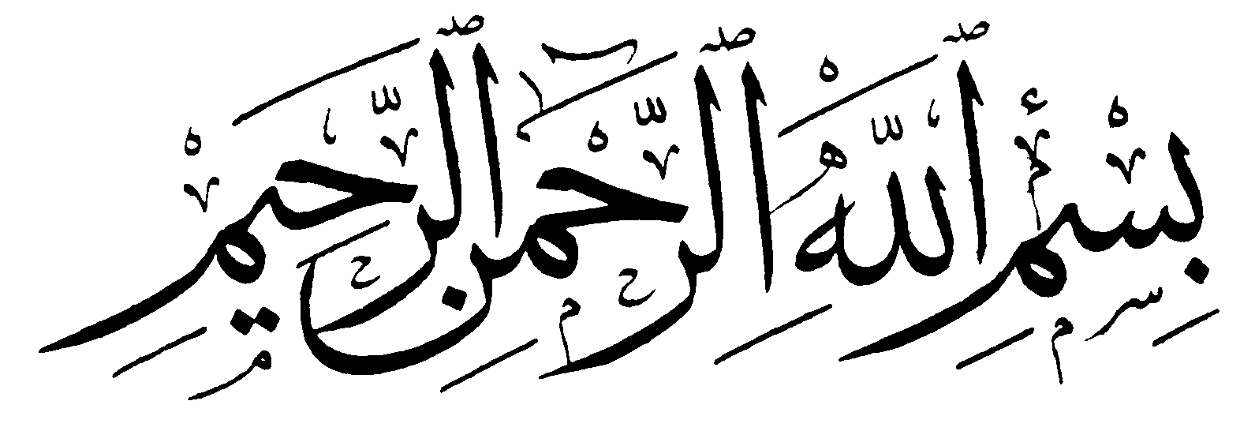
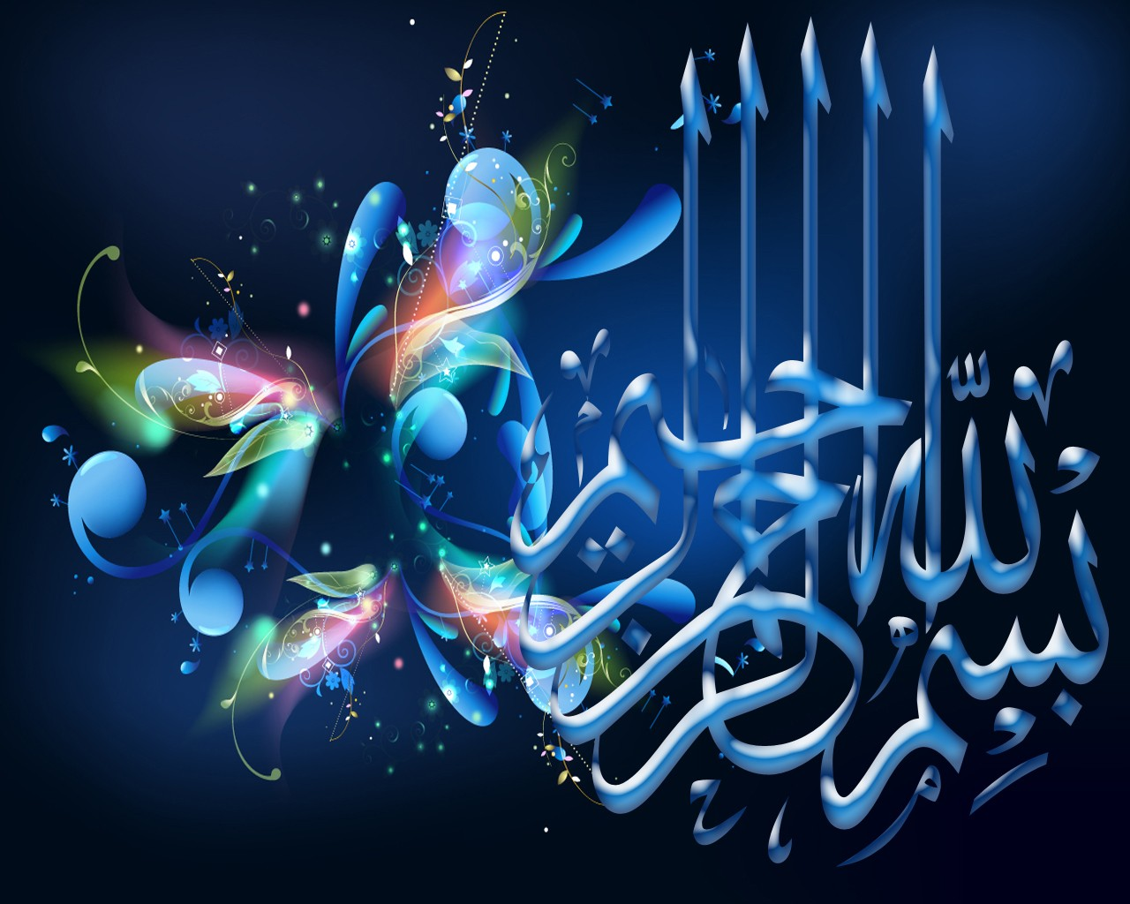

Slide 2
Islamic Studies

Slide 3

Lectuere

Slide 4
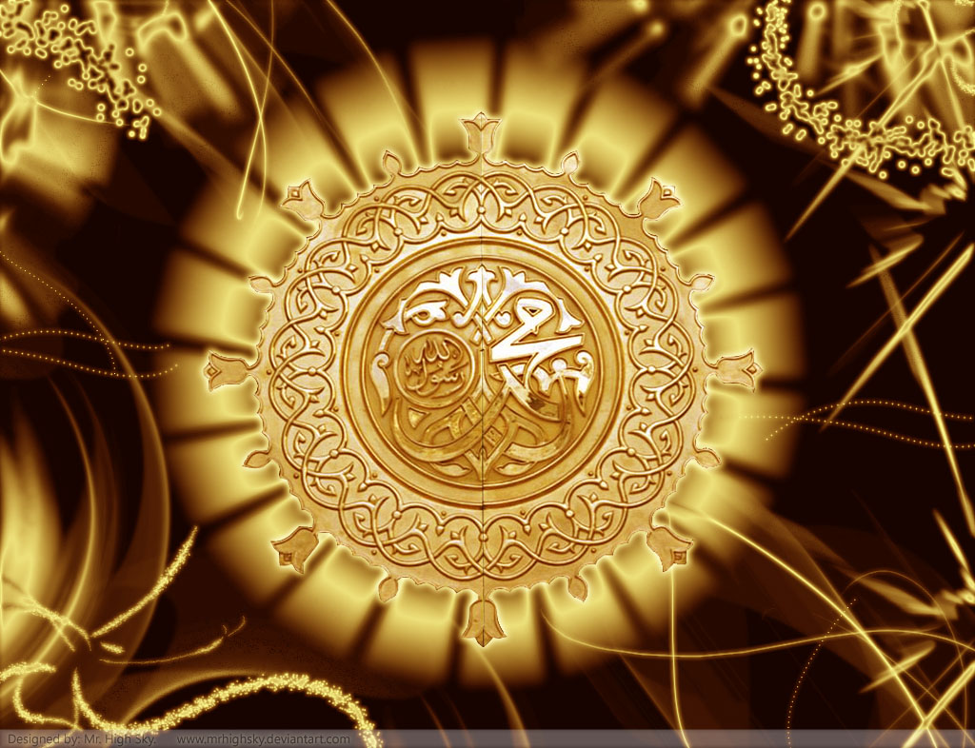
The life and significance of Holy prophet Muhammad pbuh.

Slide 5
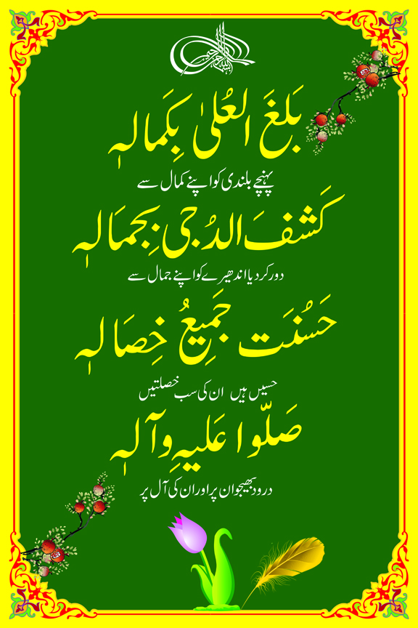

Slide 6
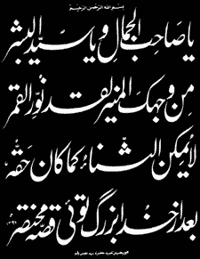

Slide 7
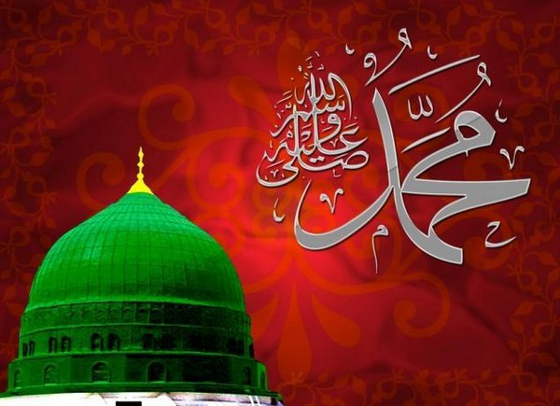
Main out Lines
The life and sighificance of the Holy prophet Muhammad pbhh.
Detail of family w shajra pak.
Makki zindgi important glimps
Madani zindgi important glimps
Khutba e hijatul wida and others
Death of prophet Muhammad pbuh.

Slide 8
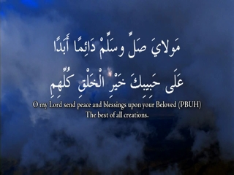
MUHAMMAD(pbuh) (pbuh)
The excellent model for humanity, the chosen one.
The light
The praised one
The best creation of almighty
The perfect man
The founder of Islam
The messenger and the last prophet
Mercy from God to all human of the world.

Slide 9
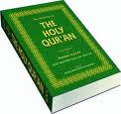
MUHAMMAD(pbuh) ’S guidance covers all walks of life
Social Life
Politics & Governance
Commerce Economy
Law & Justice
Hygiene
Human Rights & Relations
Ethics & Etiquettes
Knowledge & learning

Slide 10

ENCYCLOPAEDIA BRITANNICA
MUHAMMAD(pbuh) is the most successful of all Prophets and religious personalities.“ (11th Edition under Koran)

Slide 11
ENCYCLOPAEDIA BRITANNICA
“.... A mass of detail in the early sources show that he was an honest and upright man who had gained the respect and loyalty of others who were like-wise honest and upright men." (Vol. 12)

Slide 12
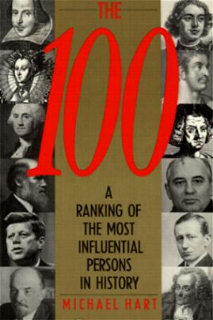
MICHAEL H. HART, ranked him 1st in the list of the Most Influential Persons in History :
"My choice of MUHAMMAD(pbuh) ( to lead the list of the world's most influential persons may surprise some readers and may be questioned by others, but he was the only man in history who was supremely successful on both the religious and secular levels.”*
* THE 100: A RANKING OF THE MOST INFLUENTIAL PERSONS IN HISTORY, New York, 1978, p. 33)

Slide 13
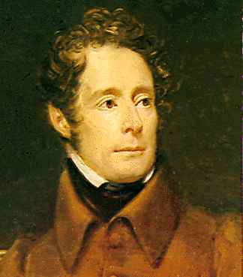
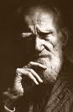
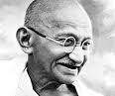
"If greatness of purpose, smallness of means, and astonishing results are the three criteria of a human genius, who could dare compare any great man in history with MUHAMMAD(pbuh) (pbuh) ?’’ - La Martine
‘‘I have studied him - the wonderful man and in my opinion for from being an anti-Christ, he must be called the Savior of Humanity.’’ - George Bernard Shaw
"I wanted to know the best of one who holds today's undisputed sway over the hearts of millions of mankind....I became more than convinced that it was not the sword that won a place for Islam in those days in the scheme of life but Holy Prophet’’ - Mahatma Gandhi

Slide 14
Seerah of Prophet Mohammad(SAW)
Makki Period

Slide 15
Family, Clan, and History
Born into the Quraysh tribe.
Descendant of Hazrat Isma’il (Alaihis-salaam), the first son of Hazrat Ibrahim (Alaihis-salaam). Born in Mecca around the year 570 A.D (more than 1400 years ago).
Father: Hazrat Abdullah (r.a.a). He passed away before the Holy Prophet (S.A.W) was born.
Mother: Hazrat Bibi Aminah (r.a.a). She passed away when Muhammed (s.a.w) was only 6 years old.
Paternal Grandfather: Hazrat Abd’ Al-Muttalib, whom the prophet (s.a.w) lived with for 8 years in his childhood.
Hazrat Abu Talib: He was the Holy Prophet’s (s.a.w) paternal uncle and raised him after Hazrat Abd- Al-Muttalib’s death.

Slide 16
Birth
Before Birth:
Rainfall occurred and Makkah started to overflow with beauty such as trees, flowers and fruits.
Hazrat Bibi Aminah (r.a.a) was told in her dream that the child she will give birth to would be the leader of the ummah and she should name him Muhammed (s.a.w).
At the time of and After Birth:
Satan screaming & crying uncontrollably and loudly.
Beautiful animals and women coming from paradise to help and comfort Hazrat bibi Aminah (r.a.a)

Slide 17
Birth
On the morning of 12, Rabbi-ul-Awwal (August, 2, 570 A.D), when the sun was rising, the Holy Prophet Mohammed (s.a.w) was born and right away he bowed down (did the sajdah) to Allah. Then he raised his two little hands together, made a dua and recited the first Kalimah tayyabbah.
There was no candle in the house but Hazrat Muhammed (S.A.W)’s noor (his spiritual light) was so much that it had lightened the whole world, east to west immensely. *Subhan-Allah*
(Qisa-sul-Anbiyah- Story Of Muhammed (s.a.w)’s Birth.)

Slide 18
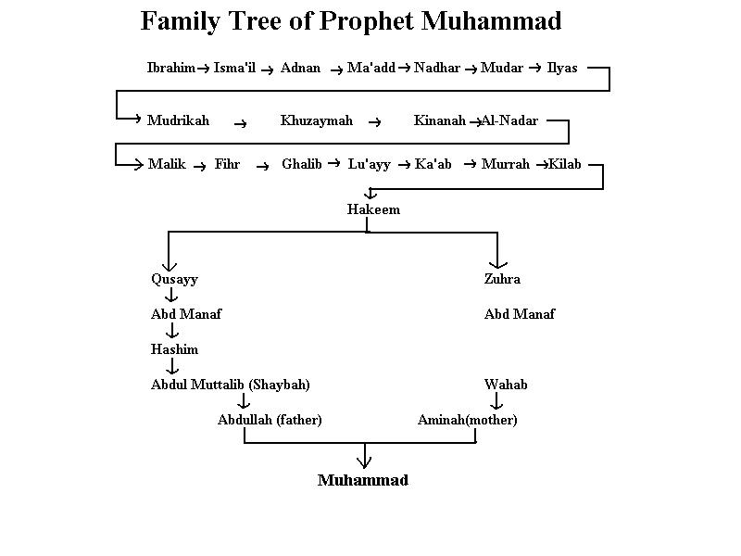
Family tree

Slide 19
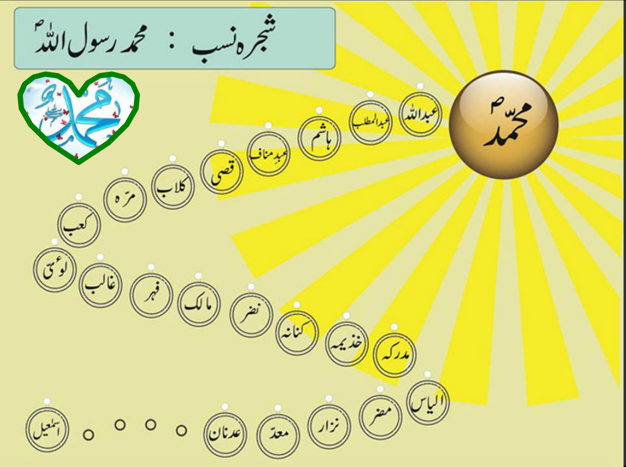

Slide 20
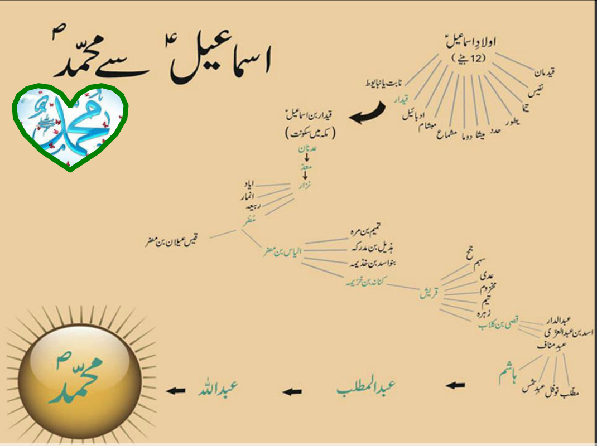

Slide 21
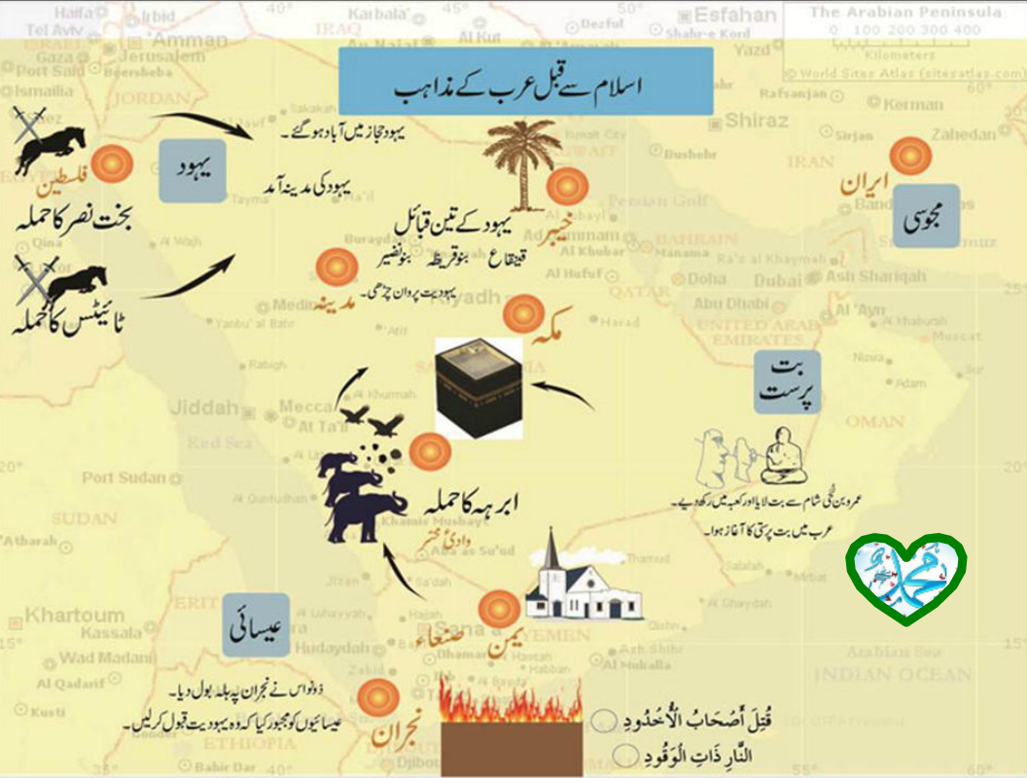

Slide 22
Arabia before and after MUHAMMAD(pbuh)
BEFORE
True Concept of God- Lost
Ignorance & Darkness
Barbarism & ruthlessness
Sexual Slavery, Nudity & Persecution of women
Usury and Exploitation
Fear and terror
Class and Color
discrimination
AFTER
True Concept of God- Restored
Knowledge & Light
Kindness & mercy
Women’s status and rights
Justice and fairness
Peace and security
Love and Brotherhood

Slide 23
MUHAMMAD(pbuh) – Youth and Marriage
Although MUHAMMAD(pbuh) grew up in such a foul society, both his friends and his enemies regarded him as the best model of chastity and virtue.(صادق و امین)
Hilful fujul
Although MUHAMMAD(pbuh) (pbuh) grew up in such a foul society, both his friends and his enemies regarded him as the best model of chastity and virtue.
Hilful fujul
MUHAMMAD(pbuh) (pbuh) married Khadija, a beautiful and honourable widow at the age of 25 while She was 40 years of age.
MUHAMMAD(pbuh) (pbuh) took other wives after her for several reasons:
C)MUHAMMAD(pbuh) married Khadija, a beautiful and honourable widow at the age of 25 while She was 40 years of age
.
MUHAMMAD(pbuh) took other wives after her for several reasons:
i) To take care of the orphans and the destitute
ii) To nullify caste systems and ignorant beliefs.
iii) To set slaves free
iv) To form friendly relations
v) To even out man : woman ratio
i) To take care of the orphans and the destitute
ii) To nullify caste systems and ignorant beliefs.
iii) To set slaves free
iv) To form friendly relations
v) To even out man : woman ratio

Slide 24
MUHAMMAD(pbuh) - Divine Revelations
By the age of 40, MUHAMMAD(pbuh) started to seek meditation and peace of mind in the Mount Hira - from the barbaric lifestyle of His society.
One day Angel Gabriel appeared before MUHAMMAD(pbuh) and said ‘‘ RECITE in the name of God’
’(95:1-5).
The Holy Quran was revealed to MUHAMMAD(pbuh) as Divine inspirations over a period of 22 years.

Slide 25
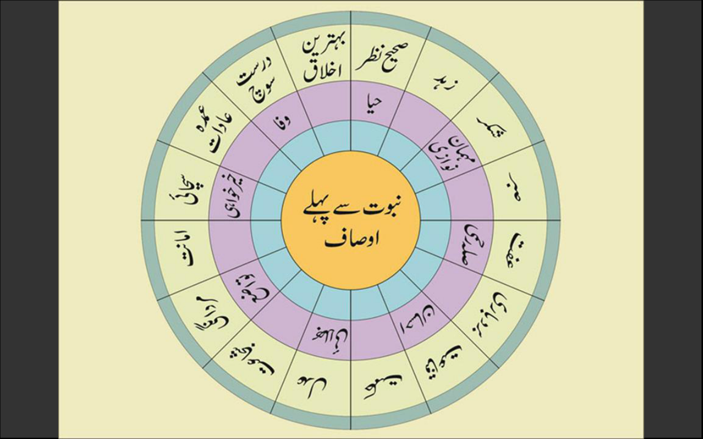

Slide 26
Life Before & After Revelation
Before revelation:
MUHAMMAD(pbuh) was a merchant.
He gained a reputation for reliability and honesty. (Al-sadiq, Al-Amin)
After revelation:
Spent in striving to spread the word of Allah.
Worshipping Allah.
Helping and guiding all.

Slide 27
Life in Makkah
As MUHAMMAD(pbuh) grew up, to earn his livelihood he pastured sheep and goats.
Then he started doing trade work. In that he showed great honesty and ethics.
First revelation at the age of forty.
Makki Surahs were revealed.

Slide 28
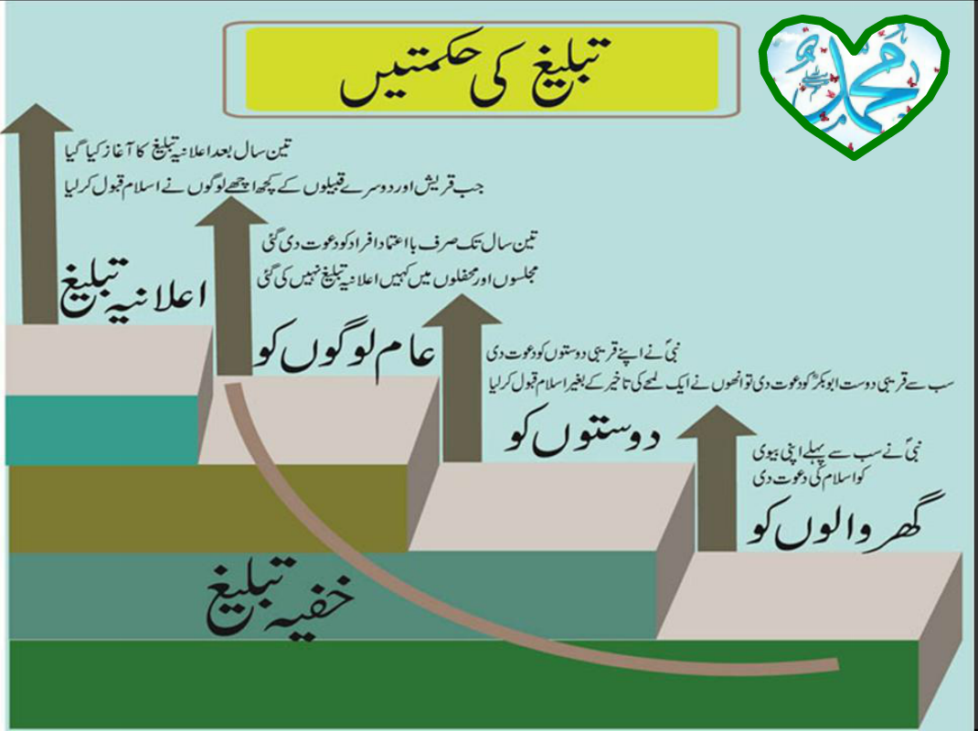

Slide 29
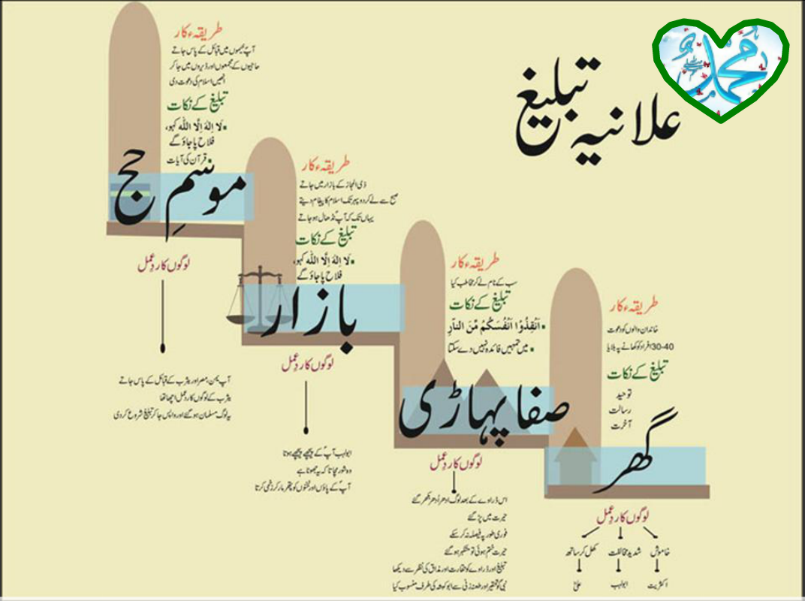

Slide 30
MUHAMMAD(pbuh) - Spread of Islam
Due to the lack of equipment and followers, MUHAMMAD(pbuh) was able to influence people to accept Islam on the basis of two things:
1. Holy Quran and its contents
2. His personality- kind and patient yet firm in His Religious duties.
To stop MUHAMMAD(pbuh) ,the Chiefs of other religions tried to offer him wealth and even cut off essential supplies from Him and His followers. However these atrocities could not hinder their spirit.

Slide 31
Migration To Madina & Life In Madina
By the permission of Allah, the Holy Prophet (pbuh) decided to migrate from Makkah to Medina as the people of Quraysh were increasing their animosity towards him.
Before migrating out of Makkah, he and his companion (sahaabbah) Siddiq-e-Akbar hid in the cave of Thaur for 3 nights.
c) The Holy Prophet (pbuh) and companion(s) also built a mosque together (the first mosque in islamic history) at the time of their stay at Quba.
d) When the Holy Prophet (pbuh) reached Medina. Everyone was overflowing with joy and respect for him. The women and children were reciting naats (talaa-al-badru-alaina).

Slide 32
Seerah of Prophet Mohammad(SAW)
Madani Period

Slide 33
Migration To Madina & Life In Madina
Masjid-Al-Nabawi, the Prophet’s (pbuh) mosque was also built.
b) The various practices of Islam (e.g: 5 prayers & Fasting in Ramadan) were also prescribed and made obligatory.
c) By Allah’s command, Hazrat MUHAMMAD(pbuh) also changed the concept of prayers facing Jerusalem to prayers facing the Ka’aba.

Slide 34
Challenges before the Islamic Movement in Madina.
Islamic state in Madina emerged needing:
Administrative structure,laws,justice,family laws.
Aggressive efforts at Dawah and attack on the false ideologies.
Settlement of the migrants in Madina with their financial support but also their Islamic education and moral training.
Prepare for Jihad and armed resistance against the enemies of Islam.
Battle of Badar,Uhad,Khandak,Tabuk and etc were fought against the enemies of Islam.

Slide 35
Hudabeya Treaty- 6 Hijra
Zeqad, 6 H, Prophet announced intention to visit Kaaba.1400 Muslims joined him.
Prophet sent someone to find pagan’s plan.
Pagans started gathering forces.
Prophet continued travel and stopped at Hudabeya.
Prophet sent Osman to negotiate.

Slide 36
Hudabeya Treaty
News came that Osman has been killed.
Bait Ridwan.Prophet gathered Muslims under a tree and took a pledge that we shall fight till we die or win.
Peace Treaty. Pagan released Osman and sent Suhail bin Amar for peace talks.
A peace treaty was concluded and written.

Slide 37
Hudabeya Treaty Terms
Muslims shall go back this year.
They shall return next year and stay for 3days
They shall not have any weapons except one sword in the shield.
They can’t take Muslims left in Mecca and shall not stop any Muslim from coming back to Meccah.
If someone goes to Madina, he shall be returned but if someone returns to Mecca, shall not be returned.

Slide 38
Hudabeya
Tribes shall have the choice to enter into treaty with Muslims or pagans.
This treaty shall be in effect for 10 years
--------------------------------------------------------
Abu Jandal’s matter.
Effects of Hudabeya.

Slide 39
Letters to Kings and Emperors 6-7 Hijra
Roman Emperor. Wahya Kalbi
Persian Emperor. Abdullah bin Huzafa Sahmi.
Aziz Misr.(Egyptian Emperor) Hatib bin Abi Baltah
Najjashi, King of Abysenia. Omar bin Umayyah.

Slide 40
Strengthening of Islamic State and Society
Attack on Khyber. Muharram, 7 Hijra.
Laws and regulations for Society.
Suras Nisaa and Maida.
Family laws,rights of men and women,inheritance law,prohibition of alcohol and gambling, law of testimony,general moral instructions.
Prophet performed Umra in 7 Hijra.

Slide 41
Victory of Mecca
Violation of Hudabeya Treaty by pagans.
Preparation to invade Mecca.10 Ramadan,8H.
Abu Sufyan is arrested and released.
Entry in Mecca.(Minimal fighting.)
Peace declaration in Mecca.
Entry in Kaaba.Removal of idols and pictures.
Victory address by the Prophet.
General amnesty.

Slide 42
Steps taken after Tabuk.
Dealings with hypocrites.
Demolition of Masjid Zirar
Not to accept their donations
No family or friendly relations with them.
Prophet should not attend their funeral.
Disciplinary action against 3 sahabas.
Clear political policy of the State.(Haj,9 H)

Slide 43
Last Haj 10 Hijra Khutbah
All methods of Jahileya are under my feet.
No Arab has superiority over non Arab.You are children of Adam and he was created from clay.
All muslims are brothers.
Feed and clothe your slaves same what you eat or wear.
Killings and Riba of Jahileya are cancelled.

Slide 44
Khutbah Last Haj
Fear Allah in the matter of women.
Your blood and your money is forbidden for each other.
If you hold fast to the book of Allah, you will not be misguided.
He asked,”Have I passed to you Allah’s message?” Everyone answered,”Yes”.
He said,”Now, you must pass on this message to those who are not here.”
Notes:
no

Slide 45
Last Sermon At Hajj
He advised:
To return goods to their rightful owners.
To hurt no one so that no one would hurt us
Bewaring of Satan for the safety of our religion
Following the five essential obligations.
He said that one day we will appear before Allah and answer for all our deeds. So, we have to stay on the path of righteousness.
(Sahih Muslim, Book of Hajj, Book 7, Number 2803)

Slide 46
Death of the Prophet
Safar,18, 11 H, he became sick.
He appointed Abu Bakr to lead the salaat.
When he was feeling a little better,he came to the masjid and gave last Khutbah.
Month of Rabiul Awwal, 11 H, he passed to Rafiq Ala.
May Allah’s blessings be upon him. He was died in 632 CE.
He was 63 when he was died.
It was very sad moment for
Muslims.
His Roza mubarik is in Medina.

Slide 47
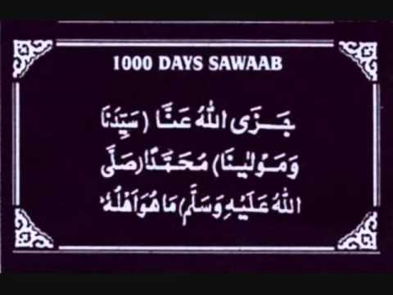

Slide 48
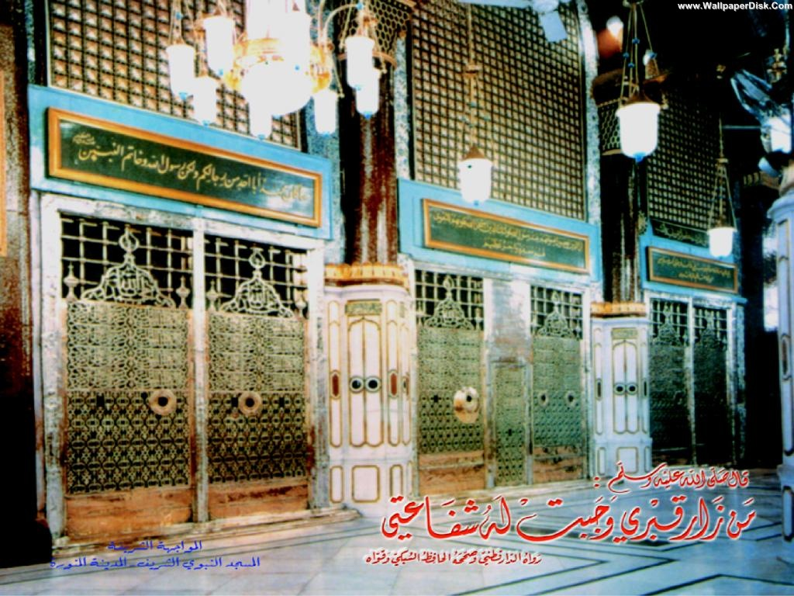
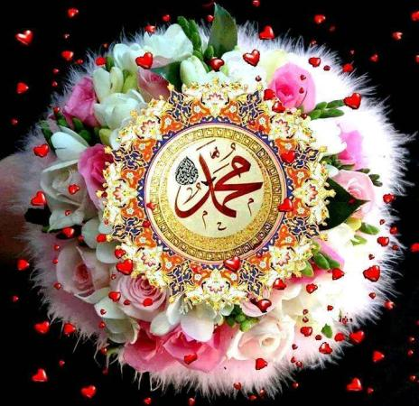

Slide 49
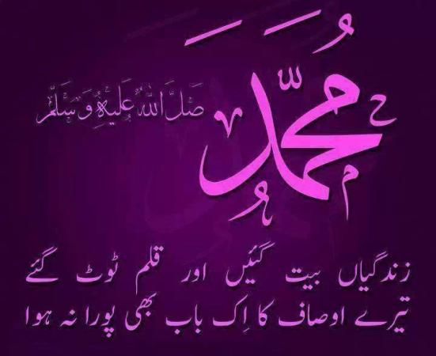

Slide 50
Summary
The life and sighificance of the Holy prophet Muhammad pbhh.
Detail of family w shajra pak.
Makki zindgi important glimps
Madani zindgi important glimps
Khutba e hijatul wida and others
Death of prophet Muhammad pbuh.

Slide 51
Ap k karne k kam? short Activitiy
What have you learnt about the life of prophet pbuh.just discuss among yourselves?
Recall few glimps of Makki period?
Recall few glimps of Madani period?
What is the best quote saying in slides about prophet pbuh by the intellectuals of the world in your vision?
Notes:
Discuss as a class the idea that Arabian Polytheism is condemned as being sinful because it goes against Tawhid.

Slide 52


